Slide 1
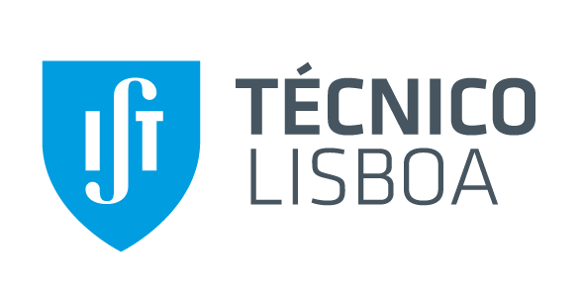


Discussion Towards a Library of Software Sustainability Requirements
This work has been partially supported by Portuguese National funds through
FITEC - Programa Interface, with reference CIT "INOV - INESC INOVAÇÃO - Financiamento Base”
Rui Carvalho
INOV.PT, IST, Universidade de Lisboa
Alberto Rodrigues da Silva
INESC-ID, IST, Universidade de Lisboa

Slide 2
Introduction
There is a growing concern regarding the deterioration of the environment.
Sustainable development implies a resource management that at the same time guarantees the satisfaction of the present and future generations.
Sustainability implies: i) product design (eco-design), ii) supply-chain management and technological new “green” solutions for production and iii) new social processes.
Using rigorous requirements specification (ITLingo RSL language - Requirements & Tests Specification Language)

Slide 3
Software Sustainability
Is software endurance that leads to software development to accomplish effective results for a long period of time [65].
The main aspects are:
Responsible use of ecological, human and financial resources during development process;
The use of resources for production [11].

Slide 4

Software Sustainability
Ecological
Financial
Human

Slide 5
Objectives
The adoption of the ITLingo RSL language to rigorously define software sustainability requirements. RSL is a controlled natural language that helps the specification of requirements and tests in a systematic and rigorous way.
Identification of Vulnerabilities and Goals for Software Sustainability.
Identification of Future Work.

Slide 6
Vulnerabilities and Goals
A vulnerability is a flaw in the system under consideration [54]. We present here vulnerabilities identified based on the work by Imran and Kosar [2].
  Vulnerabilities are classified as (1) technical vulnerabilities such as (a) software design principles; (b) coding principles; (c) user experience and (2) non-technical vulnerabilities such as (d) operational support.
We capture and define goals for sustainable software, considering the work by Imran and Kosar [2] and by Ahmad et al. [65].
  General goals are classified as quality properties like performance, maintainability, usability, etc. [40].

Slide 7
Vulnerabilities: software design principles
(V1) No change management process. There is NO proper change management process and consequently there is NO effective sustainable adaptation during the product time life.
(V2) No requirements prioritization. There is NO effective requirement prioritization process, which means the most important sustainability requirements might be neglected.
(V3) No possibility to reuse code. There is NO possibility to reuse code throughout the software development process.
(V4) No security. There is NO security concerns when designing and developing a software product.
(V5) No possible test of software product since the beginning of production. The software product is NOT available for use since the beginning of its life cycle. There is NO possibility to increase users’ loyalty and feedback because users cannot always experience the benefits of using the software.

Slide 8
Vulnerabilities: coding principles
(V6) No refactoring possibilities. There is NO tools and features to reuse old code and recreate software, consequently refactoring activities are much more difficult if not impossible.
(V7) No coding standards. Because there are NO coding standards for writing software, the development team has difficulties to present results in a coherent way.
(V8) No testing practices. During the software testing process, there is NO proper checklists and testing guidelines, so further software testing is NOT easy to implement.
(V9) No data simple stewardship. There are NO mechanisms to allow an easy and secure access of data and its manipulation.
(V10) No static analysis of software’s smells. Due to its complexity, code smells techniques are NOT easy to implement and adopt; that means that software code problems are NOT easily identifiable.

Slide 9
Vulnerabilities: user experience
(V11) No end-users feedback communication. There is NO communication and feedback channels between end-users and software owners, for example to report and notify about suggested improvements or bugs.
(V12) No effective and efficient graphical user interface. The graphic user interface does not allow an effective and efficient end-user interaction.

Slide 10
Vulnerabilities: operational support
(V13) No effective documentation to support development. There is NO effective documentation to ensure that the software related documents (e.g., requirements document, design document, test document, and maintenance document) provide a clear and precise communication among the technical and non-technical stakeholders.
(V14) Not compliant with sustainability manifestos’ principles. There are NO concerns with sustainability manifestos’ principles, the commitments and policies which must be followed by a software stakeholder to ensure sustainability.
(V15) No training. There is NO training of software engineers or end-users, respectively on the technical and use techniques.
(V16) No funding for sustainable software. There is NO funding or there is NO sum of money which is provided to software teams to build more sustainable software.
(V17) No leadership for change management. There is no leadership or, in other words, there are NO skills through which a project manager handles change management, as well as time, cost management, or HR management [14].

Slide 11
Technical Software Goals
(G1) Software product shall be flexible and easy to be adapted. The software product shall have the capability of adaptation, presenting no major changes and no need for new training for end-users, saving time and other resources. (Type: Maintainability; SubType: Maintainability_Reusability)
(G2) Software product shall be effective. The software product shall obtain valuable results. (Type: Reliability; SubType: Reliability_Maturity)
(G3) Software product shall be efficient. (Type: Performance; SubType: Performance_DiskCapacity)

Slide 12
Non-technical Software Goals
(G4) Software product shall contribute to costs reduction. From business perspective a sustainable software shall contribute to profit increase. (Type: Performance; SubType: Performance_SystemResponseTime)
(G5) Software product shall contribute to the scientific progress. Software product shall have an important role as a tool for research. There is a need for training, prototyping and implementations with a goal for more sustainable software. (Type: Usability; SubType: Usability_Operability)

Slide 13
Relations: Vulnerabilities vs Goals
Table I. Links Between Goals and Vulnerabilities
 |  | Goals (Solutions)
 |  | G1 | G2 | G3 | G4 | G5
Vulnerabilities (Problems) | V1 | X | X | X | X | X
 | V2 | X | X | X | X | X
 | V3 | X | X | X | X | X
 | V4 | X | X |  | X | X
 | V5 | X | X | X | X | X
 | V6 | X | X |  | X | X
 | V7 | X | X |  | X | X
 | V8 | X | X |  | X | X
 | V9 | X | X |  | X | X
 | V10 | X | X |  | X | X
 | V11 |  | X |  | X | X
 | V12 |  |  |  | X | X
 | V13 | X | X | X
 | V14 |  |  |  | X
 | V15 |  |  |  | X
 | V16 |  | X |  | X
 | V17 | X | X

Slide 14
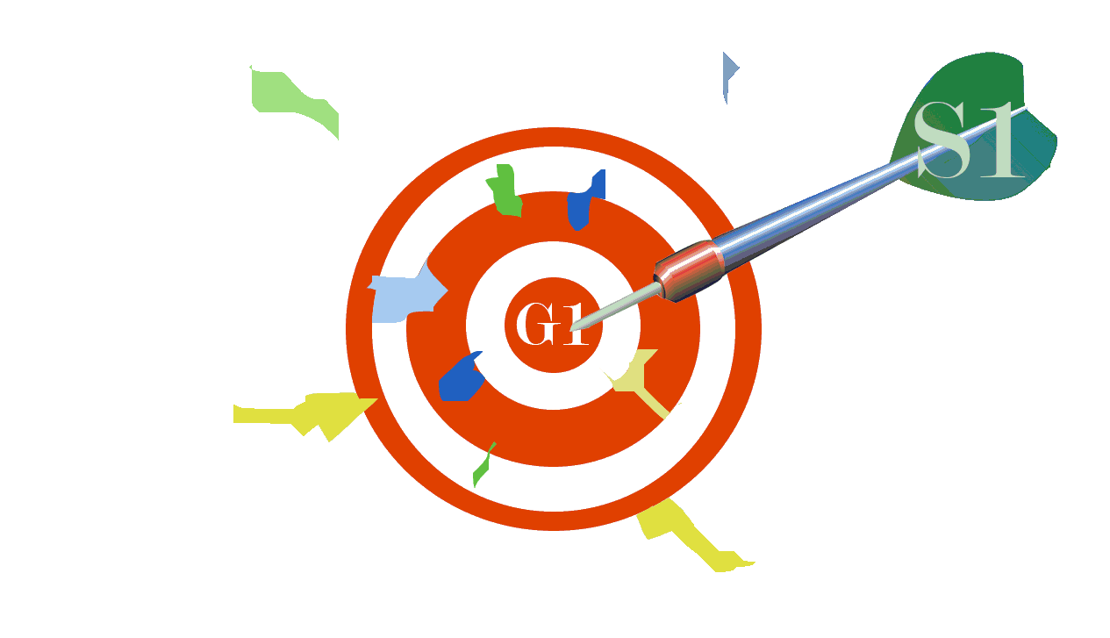

Software Change Management (SCM) process for flexibility and easy adaptation
(S1) Implement a Software Change Management (SCM) process
Software product shall be flexible and easy to be adapted (G1)
No change management process (V1)

Slide 15
Main contributions
Our first contribution to the field of sustainable software using RE:
identifying and specifying vulnerabilities and goals possibly capable to obtain a new generation of more sustainable software, in such a way that even software users might experience a higher level of awareness then today.
Example of applicability:
the growing number of smartphones [71] and the high volume of energy consumption they create due to a growing number of mobile software products [63].

Slide 16
Future Work
i) looking closely to energy consumption in relation with software performance and structure;
ii) development of a vulnerability scoring system simple and adapted to software sustainability;
iii) creation of tests and recommendations for industry;
iv) creation of a reusable library of concerns for software sustainability, using ITLingo-Studio and RSL technologies, to specify rigorous requirements;

Slide 17

Summing up…
We would like to test software to identify improvements from a sustainability point of view.

Slide 18
Some Bibliography
[2] A. Imran and T. Kosar, “Software Sustainability: A Systematic Literature Review and Comprehensive Analysis”, Journal of Information and Software Technology, 2019
[3] A. Malhotra, N. Melville and R. Watson, “Spurring Impactful Research on Information Systems and Environmental Sustainability”, MIS Quarterly, vol. 37, pp. 1265-1274, 2013.
[11] B. Penzenstadler, “Infusing Green: Requirements Engineering for Green In and Through Software Systems”, Third International Workshop on Requirements Engineering for Sustainable Systems, pp. 44-53, 2014.
[36] I. Wallimann-Helmer, L. Meyer, K. Mintz-Woo, T. Schinko and O. Serdeczny in R. Mechler, L. Bouwer, T. Schinko, S. Surminski and J. Bayer, “Loss and Damage from Climate Change Chapter 2: The Ethical Challenges in the Context of Climate Loss and Damage”, Springer Open, 2019, pp. XXII + 557.
[38] INESC-ID (2017), “ITLingo”, itbox.inesc-id.pt/ITLingo
[40] ISO IEC (25010:2011): Systems and software engineering – systems and software quality requirements and evaluation (SQuaRE)
[54] M. Bishop, “Vulnerabilities Analysis”, International symposium on recent advices in intrusion detection, 1999.
[65] R. Ahmad, A. Hussain, and F. Baharom, “Software Sustainability Characteristic for Software Development towards Long Living Software”, WSEAS TRANSACTIONS on BUSINESS and ECONOMICS, vol. 15, 2018.

